Slide 1
CIDM 6312 – Seminar in Data Visualization.
HW 4
Submitted by: tiwalope shadare

Slide 2
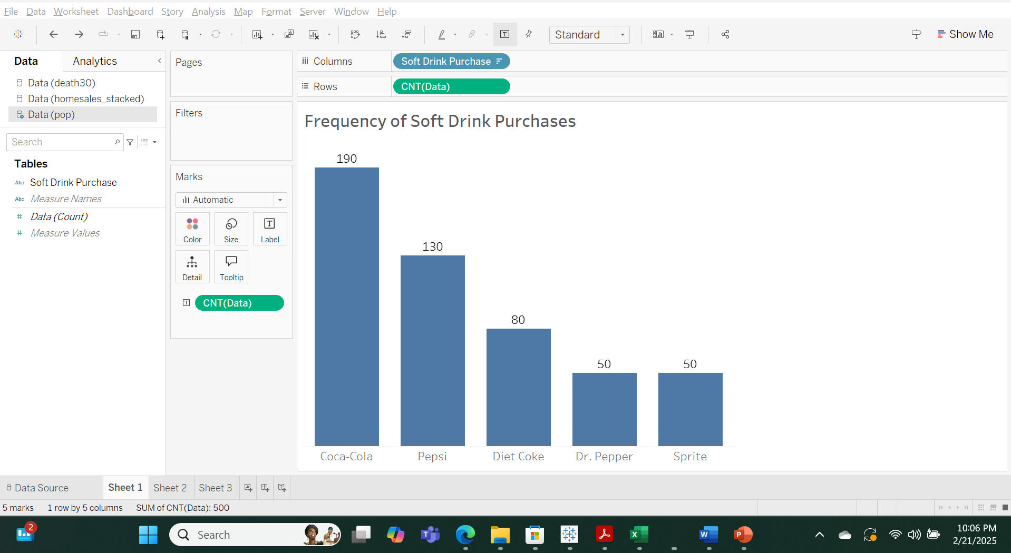
Part 1 - Column chart showing frequency distribution of soft drink purchased by TS.

Slide 3
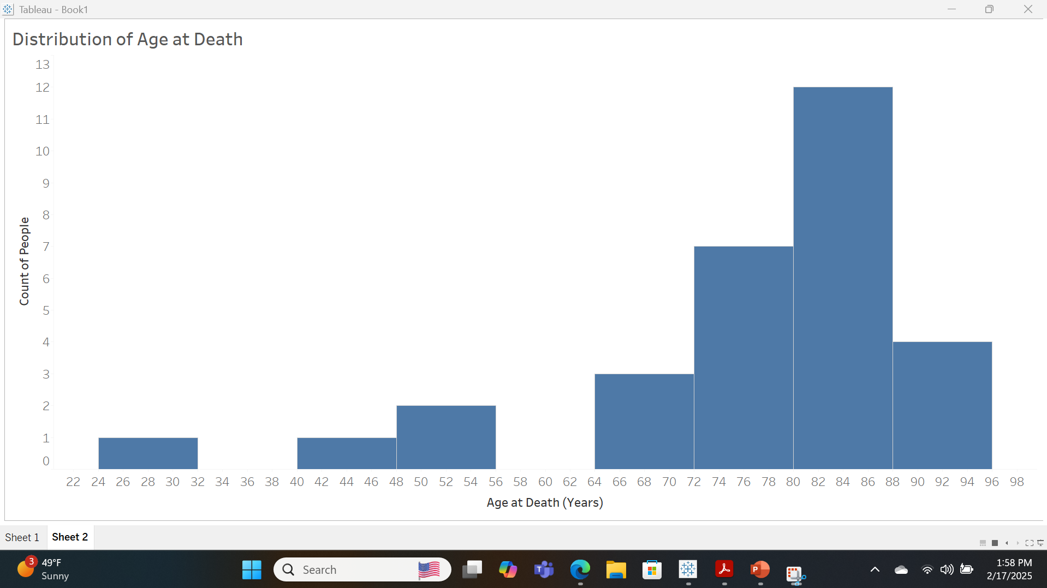
Part 1 - Histogram showing Age of Death frequency distribution by TS.

Slide 4
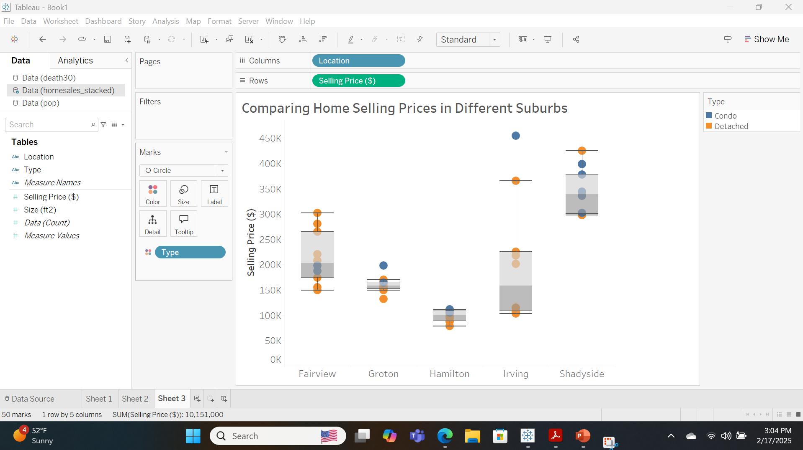
Part 1 - A Box and Whisker Plot illustrating home sales data by TS.
Interpretation
This box and whisker plot provides a graphical distribution of data among the suburbs in our list. The interquartile range is the shaded area which shows where the middle 50% of the data are represented. Data outside of the whiskers are outliers.
Overall, we can see that Irving and Groton suburbs have outliers –both condos.
Collectively, the Hamilton suburb has the least expensive homes while the Shadyside suburb has the most expensive homes.

Slide 5
Part 1 – Comparison and Analysis of Box and Whisker Plot
Fairview: Distribution is symmetrical with a median price of $203, 000. There are no extreme outliers with low or high values
Groton: Distribution is symmetrical with less dispersion than Fairview. The median price of $158, 000 for a home. There are a few outliers – a detached out with a low value of $132, 000 and a condo with a slightly high value of $198,000
Hamilton: This suburb has the cheapest houses on our list with a median home price of $100,000. The distribution has a slight downward (negative) skewness with most home prices in the upper range.
Irving: Distribution has an upward (positive) skewness with most homes having a low home price. There are a few outliers with some high home prices, for example, we have a condo priced at $454,000. The Irving suburb has a median home price of $158,000, which is the same as the Groton suburb.
Shadyside: The Shadyside suburb has the most expensive houses on our list with a median home price of $339,000. The distribution has an upward (positive) skewness with most of the home prices in the lower range and a few in the upper range.

Slide 6
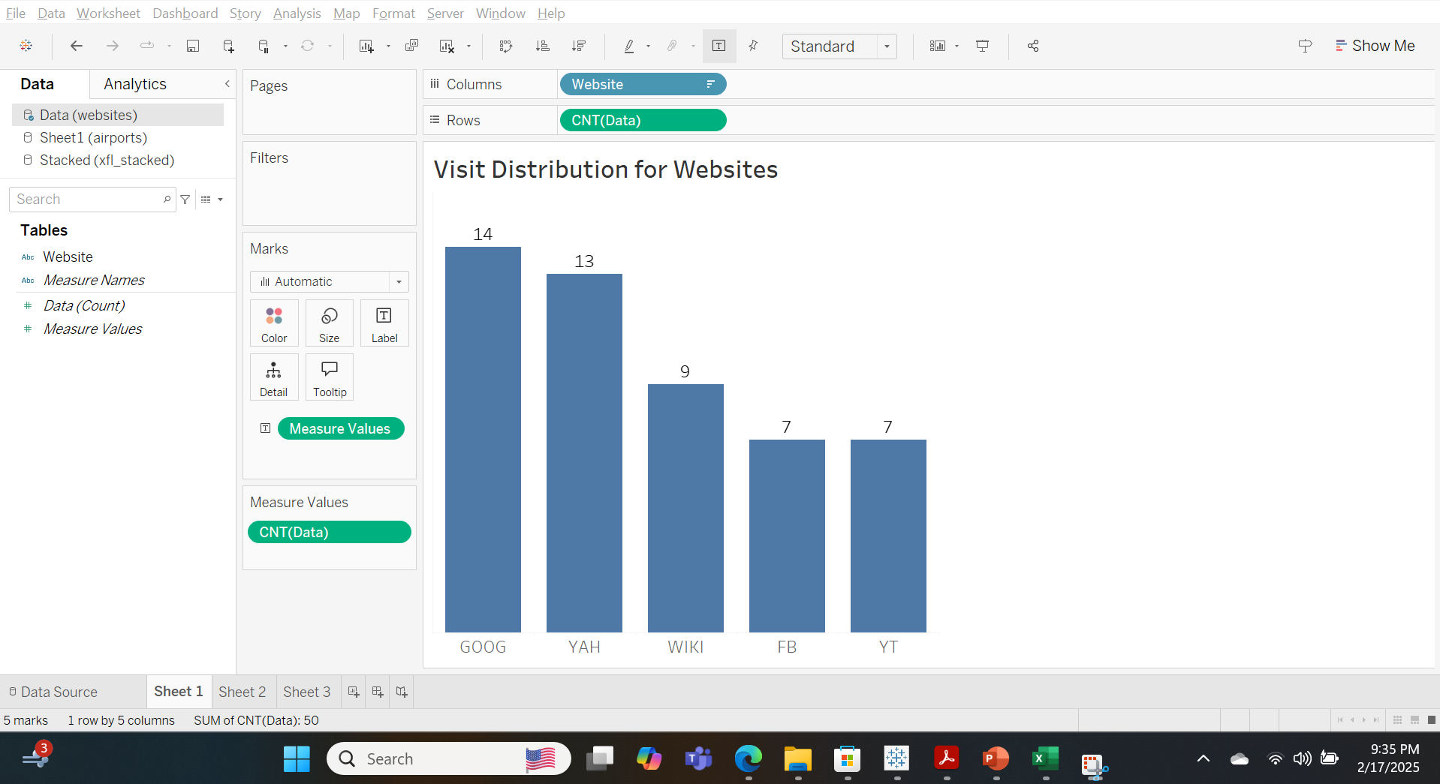
Part 2 – Column Chart illustrating the distribution of visits to selected websites by TS
The distribution of websites shows that the most frequently visited website is www.google.com, while the second most frequently visited is www.yahoo.com.
It also shows that there is a two-way tie for the least visited websites which are www.facebook.com and www.youtube.com.

Slide 7
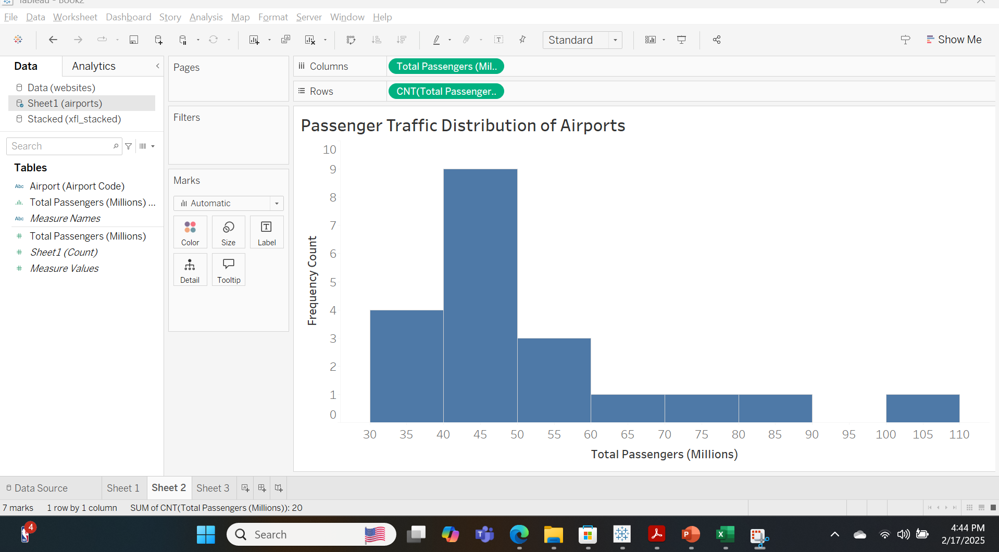
Part 2 - Histogram for the distribution of traffic in Airports by TS.
The passenger traffic distribution is skewed to the right. The highest concentration falls within the 40 – 50 million range (bin), followed by the 30-40 million range, which has the second highest concentration. There are a few outliers observed in the 100 – 110 million range. Notably, the 90 – 100 million bin shows no entries.

Slide 8
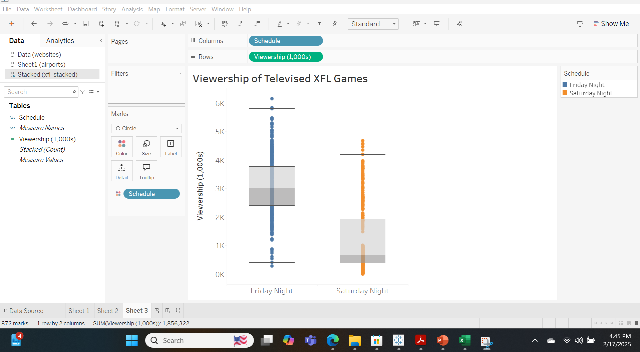
Part 2 - Box and Whisker Plot showing viewership of XFL games on television by TS.
Friday Night viewership: The distribution of the viewership is relatively symmetrical with a few outliers at the lower and upper ends. With a median of approximately 3,000, it surpasses the Saturday night viewership.
Saturday Night viewership: With a median of 677, it has an upward (positive) skewness with most of its distribution having a low viewership. There are some upper-end outliers, suggesting that a couple of games have a high viewership – the highest being over 4,600.

